Slide 1
Backtracking and Branch-and-Bound

Slide 2
Expected Outcomes
Describe the ideas of backtracking and branch and bound techniques
Solve some difficult problems by the backtracking technique

Slide 3
Exact Solutions
exhaustive search (brute force)
  Generate ALL candidate solutions and identify one with a desired property
  useful only for small instances
Improvement over exhaustive search: backtracking and branch-and-bound
  The idea
    construct candidate solutions one component at a time based on a certain rule.
    If no potential values of the remaining components can lead to a solution, the remaining components are not generated at all.
  Difference
    Apply to different problems (non-optimization and optimization problems)
    The way a new component is generated.
  Advantage and disadvantages
    cut down on the search space
    provide fast solutions for some instances
    the worst case is still exponential
Notes:
The procedure of composing a state-space tree is the procedure to construct a solution.
Each node reflects the fact that a new component of a candidate solution is generated.
When the tree is done, it means a path exists leading from the root, the original state to the final objective state.

Slide 4
Backtracking
Construct the state space tree:
  Root represents an initial state
  Nodes reflect specific choices made for a solution’s components.
    Promising and nonpromising nodes
    leaves
Explore the state space tree using depth-first search
“Prune” non-promising nodes
  dfs stops exploring subtree rooted at nodes leading to no solutions and...
  “backtracks” to its parent node

Slide 5
Example: The n-Queen problem
Place n queens on an n by n chess board so that no two of them are on the same row, column, or diagonal

Slide 6
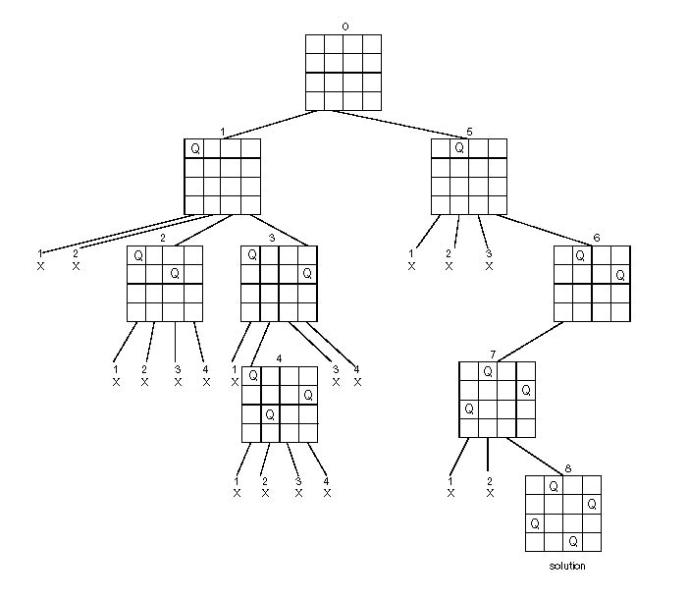
State Space Tree of the Four-queens Problem

Slide 7
The m-Coloring Problem and Hamiltonian Problem
2-color
3-color
Hamiltonian Circuit
  (use alphabet order to
  break the ties)
a
c
d
b
e
Notes:
Careful to draw the state-space by coloring vertices in alphabetical order.
This way you get some actual “backtracking” – most small examples of graph coloring
yield a solution so fast that it is hard to appreciate what is going on.

Slide 8
Comments
Exhaustive search and backtracking
  Exhaustive search is guaranteed to be very slow in every problem instance.
  Backtracking provides the hope to solve some problem instances of nontrivial sizes by pruning non-promising branches of the state-space tree.
The success of backtracking varies from problem to problem and from instance to instance.
  Backtracking possibly generates all possible candidates in an exponentially growing state-space tree.
  But still it provides a systematic technique to do so.
Notes:
Generate all n-bit binary strings.

Slide 9
Branch and Bound
An enhancement of backtracking
  Similarity
    A state space tree is used to solve a problem.
  Difference
    The branch-and-bound algorithm does not limit us to any particular way of traversing the tree and is used only for optimization problems
    The backtracking algorithm requires the using of DFS traversal and is used for nonoptimization problems.

Slide 10
Branch and Bound
The idea
Set up a bounding function, which is used to compute a bound (for the value of the objective function) at a node on a state-space tree and determine if it is promising
  Promising (if the bound is better than the value of the best soluton so far): expand beyond the node.
  Nonpromising (if the bound is no better than the value of the best solution so far): not expand beyond the node (pruning the state-space tree).

Slide 11
Traveling Salesman Problem
  An obvious way to construct the state-space tree
  A node: a node in the state-space tree; a vertex: a vertex in the graph.
  A node that is not a leaf represents all the tours that start with the path stored at that node; each leaf represents a tour (or nonpromising node).
  Branch-and-bound: we need to determine a lower bound for each node
    For example, to determine a lower bound for node [1, 2] means to determine a lower bound on the length of any tour that starts with edge 1—2.
  Expand each promising node, and stop when all the promising nodes have been expanded. During this procedure, prune all the nonpromising nodes.
    Promising node: the node’s lower bound is less than current minimum tour length.
    Nonpromising node: the node’s lower bound is NO less than current minimum tour length.

Slide 12
Traveling Salesman Problem—Bounding Function 1
Because a tour must leave every vertex exactly once, a lower bound on the length of a tour is the sum of the minimum (lower bound)cost of leaving every vertex.
  The lower bound on the cost of leaving vertex v₁ is given by the minimum of all the nonzero entries in row 1 of the adjacency matrix.
  …
  The lower bound on the cost of leaving vertex v_{n} is given by the minimum of all the nonzero entries in row n of the adjacency matrix.
Note: This is not to say that there is a tour with this length. Rather, it says that there can be no shorter tour.
Assume that the tour starts with v1.

Slide 13
Traveling Salesman Problem—Bounding Function 2
Because every vertex must be entered and exited exactly once, a lower bound on the length of a tour is the sum of the minimum cost of entering and leaving every vertex.
  For a given edge (u, v), think of half of its weight as the the exiting cost of u, and half of its weight as the entering cost of v.
  The total length of a tour = the total cost of visiting( entering and exiting) every vertex exactly once.
  The lower bound of the length of a tour = the lower bound of the total cost of visiting (entering and exiting ) every vertex exactly once.
    Calculation:
      for each vertex, pick top two shortest adjacent edges (their sum divided by 2 is the lower bound of the total cost of entering and exiting the vertex);
      add up these summations for all the vertices.
Assume that the tour starts with vertex a and that b is visited before c.

Slide 14
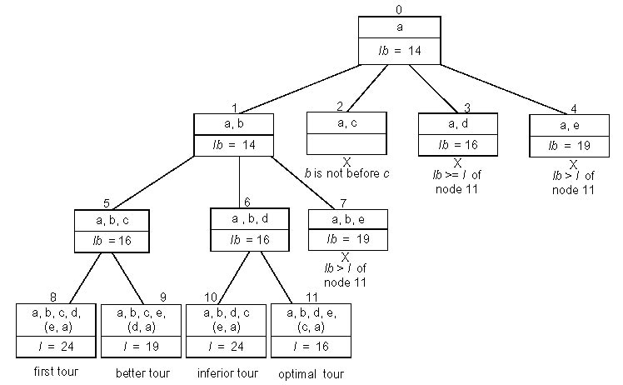
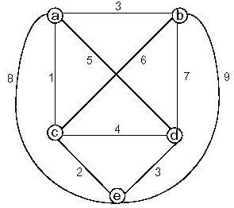
Traveling salesman example 2

